Slide 1

Stepup
Grab a shoe from the best

Slide 2
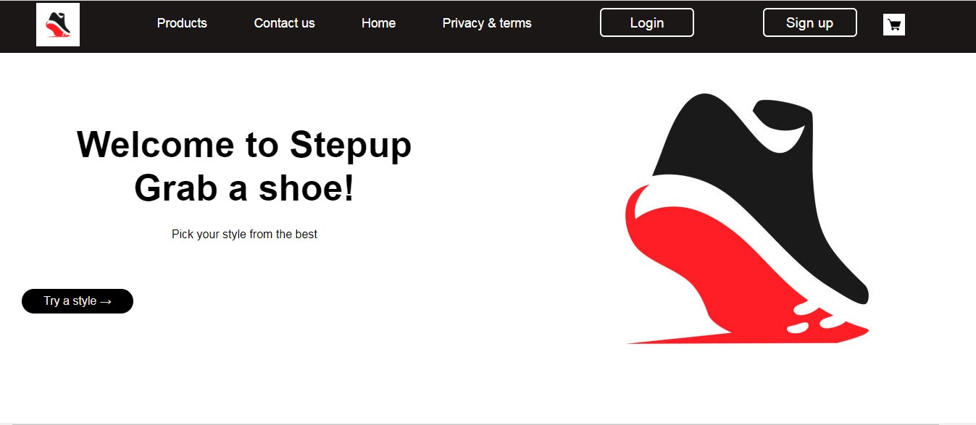
Home page

Slide 4
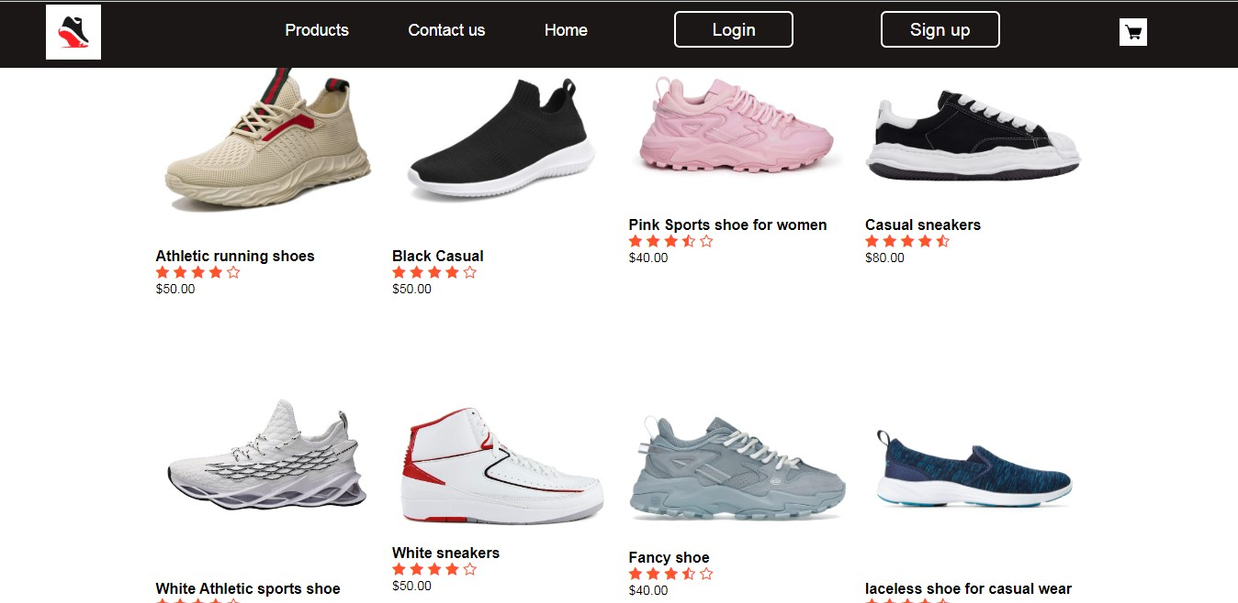
Product page

Slide 5
Cart

Slide 6

Login page

Slide 7
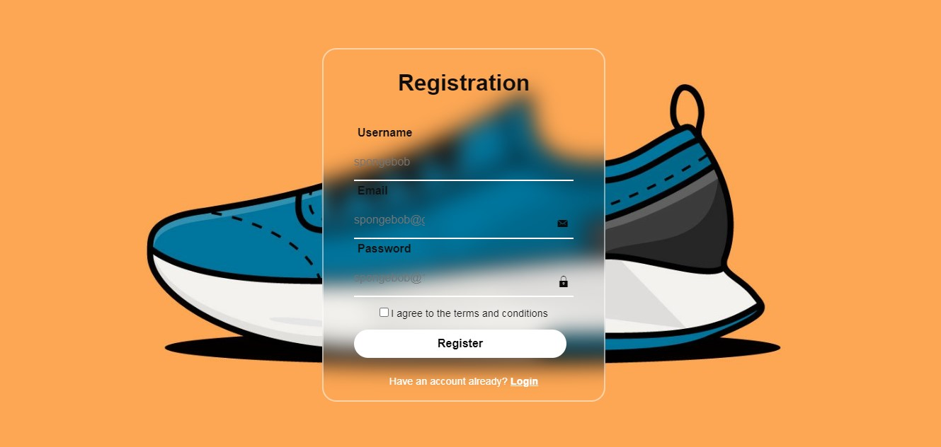
Registration page

Slide 8
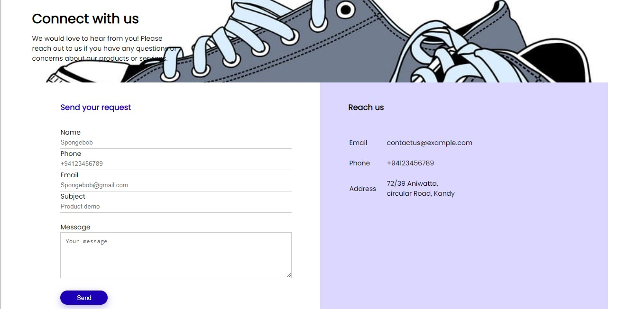
About us

Slide 9
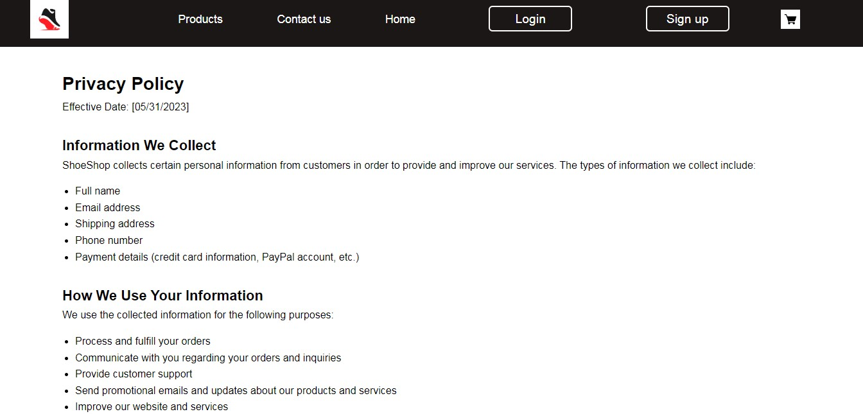
Privacy policy page

Slide 10
